Slide 1
Singapore National Health Insurance
Dr Benjamin Cheah

Slide 2
Paying for medical expenses in Singapore
Government subsidies
Savings - Medisave
Insurance – Medishield & Eldershield
Endowment fund –Medifund

Slide 3
Types & Nature
Types
Eldershield 400
Medishield
Nature
Opt out scheme
Insurance. Not subsidy, charity or savings program
No surrender value
Declaration of current disability / current illness
Both are upgradeable to higher payouts
Medishield is run by CPF, eldershield is outsourced to 3 private insurance ( NTUC, Aviva & Great Eastern)
All insurance is measure of risk & rewards

Slide 4
Eldershield 400
ElderShield is an affordable severe disability insurance scheme which provides basic financial protection to those who need long-term care, especially during old age. It provides a monthly cash payout to help pay the out-of-pocket expenses for the care of a severely-disabled person
As many as 1 in 12 elderly persons suffer from disabilities as a result of aging and illness which make them incapable of doing simple everyday activities. These people need long term care which can be expensive and may require financial help.

Slide 5
Eldershield 400
> 40 years old
Currently not disabled
Fixed premiums from 40-65 years old
Covers severe disability
Payout $400 x 72 months
Entry age premiums at 40
Male $174 vs Female $217

Slide 6
Eldershield payout
ElderShield provides a cash payout of every month to those who are severely disabled, those who are not able to do 3 or more of the following Activities of Daily Living
A. Washing
B. Dressing
C. Feeding
D. Toileting
E. Mobility
F. Transferring

Slide 7
Questions
1.What are the illness that can cause such disability?
2. When do you expect these disabilities to occur?
3. How long do you expect a seriously disabled person to live?
4. Money matters
5. Who should take up eldershield?

Slide 8
Finance
Premium
$217x25=$5425
Power of Inflation
0.97³⁰=0.41
$400 x 0.41 = $160
Payouts
$400 x 72=$28 800
Not lump sum
Payout begins after claim is made.
No backdate.
Chance of payout 1:12

Slide 9
Questions
1.What are the illness that can cause such disability?
2. When do you expect these disabilities to occur?
3. How long do you expect a seriously disabled person to live?
4. Money matters
5. Who should take up eldershield?

Slide 10
Comparison of medishield & NUTC enhanced income shield

Slide 11
Health Declaration
Except for new-borns covered from their date of birth, members and/or their dependants are required to declare any pre-existing health conditions before their MediShield covers commence.
The Board will not consider claims from members who have given false or misleading information, or who have withheld material information when declaring their health conditions. In such events, their MediShield covers may also be cancelled.

Slide 12
MEDISHIELD
MediShield is a low cost basic medical insurance scheme. Introduced in 1990, the government designed MediShield to help members meet large Class B2/C hospitalization bills, which could not be sufficiently covered by their Medisave balances
MediShield operates with co-payment features such as co-insurance and deductible where patients share part of the responsibility for their medical expenses. The co-insurance and deductible can be paid using Medisave or cash.
Premiums for MediShield can be paid by Medisave.

Slide 13
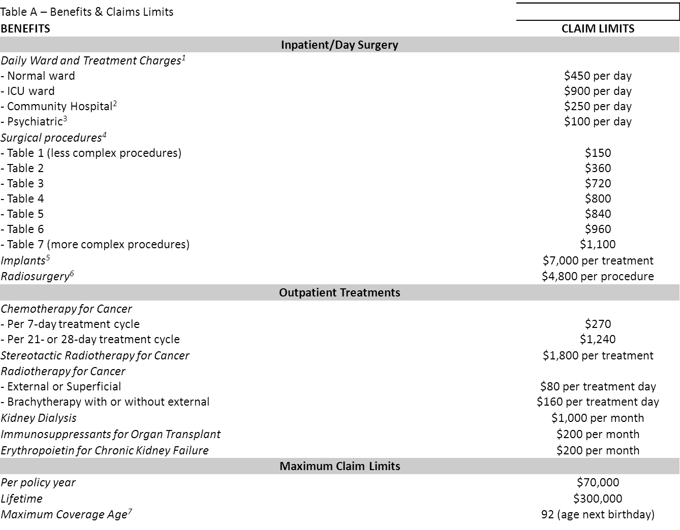
Medishield benefits and claim limits:

Slide 14
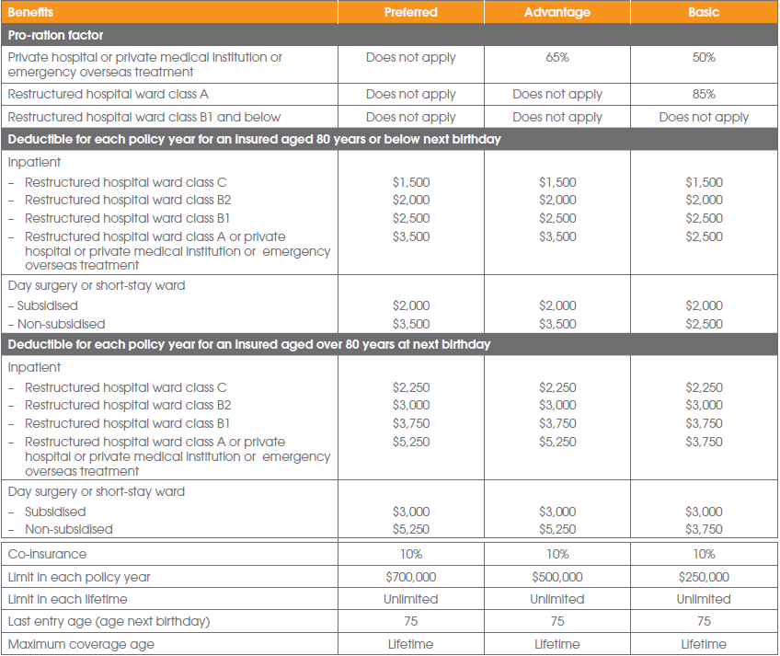
NTUC income shield

Slide 15
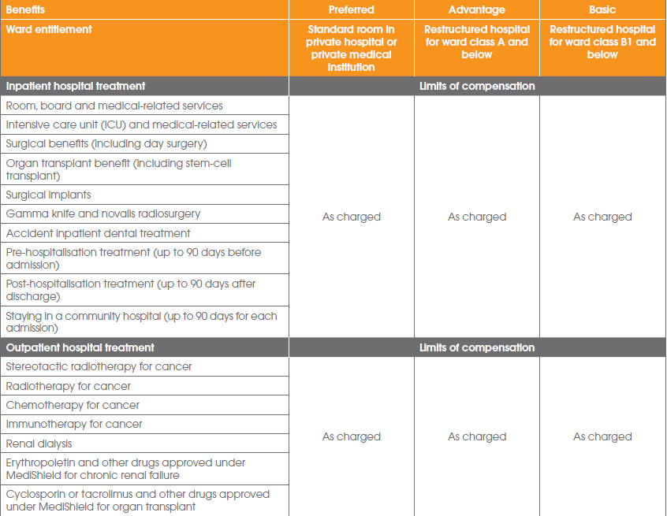

Slide 16
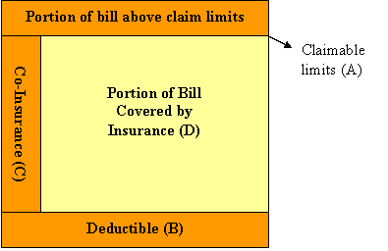
Deductible
A deductible is the initial amount you need to pay for claim(s) made in a policy year, before there is MediShield payout.
You only need to pay the deductible once in a policy year.
The deductible helps to sieve out small claims, which can be paid using Medisave and/or cash, and keeps MediShield premiums affordable.
For approved outpatient treatments claimable under MediShield, the deductibles are waived and a 20% co-insurance is applicable. Some examples are outpatient chemotherapy and radiotherapy for cancer as well as kidney dialysis.

Slide 17
Claimable Limits
It refers to the portion of your medical bill that is eligible for MediShield reimbursement.
Your Claimable Limit, or claim amount, is determined by the maximum limit applicable to each type of expenses, e.g. charges incurred per day of hospitalization, surgical procedures, surgical implants, and approved specific treatments and outpatient treatments.

Slide 19
Co- insurance
It is the percentage of the bill you need to pay on the portion of the bill above the deductible
It is 3 tiered ranging from 10-20%, the larger the bill, the lower the co-insurance

Slide 20
Ward Class
 | Class C | Class B2 & Above
Deductible Per Policy Year (aged 80 and below next birthday) | $1,500 | $2,000
Deductible Per Policy Year (aged 81 to 90 next birthday) | $2,000 | $3,000
Co-Insurance | Claimable Amount $1,501 - $3,000 : 20% $3,001 - $5,000 : 15% Above $5,000: 10% | Claimable Amount $2,001 - $3,000 : 20% $3,001 - $5,000 : 15% Above $5,000: 10%

Slide 21
MediShield Premiums
Premiums for MediShield are kept low and affordable to encourage participation in the scheme.
You can use your Medisave to pay for MediShield premiums.
Age Next Birthday | MediShield Yearly Premiums
1 to 20 | 50
21 to 30 | 66
31 to 40 | 105
41 to 50 | 220
51 to 60 | 345
61 to 65 | 455
66 to 70 | 540
71 to 73 | 560
74 to 75 | 646
76 to 78 | 775
79 to 80 | 865
81 to 83 | 1,123
84 to 85 | 1,150
86 to 90 | 1,190

Slide 22
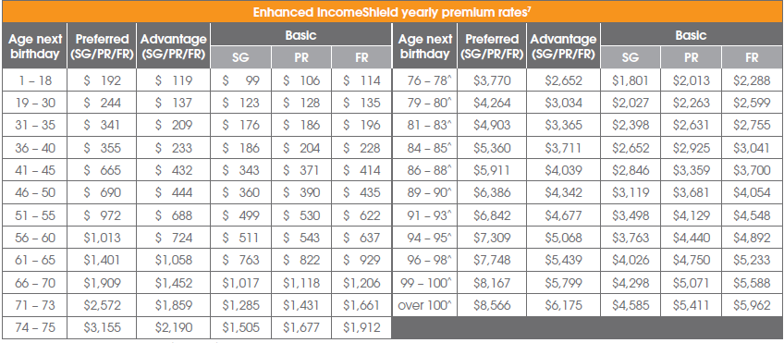
Premium rates for NTUC enhanced income shield

Slide 23
Premiums between Medishield and NTUC basic for Singaporeans
 | Medishield | NTUC basic SG
40 yr | 105 | 186
60 yr | 345 | 511
70 yr | 540 | 1017

Slide 25
How Medi Shield Works
Example: A patient staying in Class C incurs a bill of $8,000. If all the expenses are within the MediShield claimable limits (A), the total claimable amount is $8,000.
(B) Deductible As he is staying in a Class C ward, the deductible payable by the policyholder is $1,500.
(C) Co-insurance The co-insurance he has to pay is computed as follows: - 20% of the claimable amount from $1,501 to $3,000: 20% x $1,500 = $300 - 15% of the claimable amount from $3,001 to $5,000: 15% x $2,000 = $300 - 10% of the claimable amount above $5,000: 10% x $3,000 = $300 Hence, the total co-insurance payable is $900 (i.e. $300 + $300 + $300).
Final MediShield payout Out of the total $8,000, the patient will need to pay $2,400 ($1,500 for deductible and $900 for co-insurance) by Medisave or cash.

Slide 26
Questions
When do you expect to activate medishield?
How much premium would you have paid by then?
How much can medisave or income shield help?

Slide 27
Hospital bill size http://www.moh.gov.sg/content/moh_web/home/costs_and_financing/HospitalBillSize.html The medical fees are based on the 50 percentile for B2 charges at NUH
Outpatient/Day surgery
Cancer variable
Cataract surgery $993
Carpal Tunnel $619
OGD / colonoscopy $277 / $ 345
Dialysis (patient @ NKF blog)
$130/session at full cost.
$130 x 12 = $1560
Needy patients pay < $50/session
Inpatient
Anemia $1064
Asthma $370
Stroke $1769
Heart failure $1415
AMI with PTCA $4768
Hernia Op $1401
TKR $5727
Bypass $6268

Slide 28
Cancer
Medisave pays $270 per week or $1240 per month
Dialysis
Medisave pays $1000 per month
So if the full cost of dialysis is $1560, you can only pay $560 per month or $ 6720 per year
At 60 yrs old , premium is $1150 which can be paid by medisave
Bypass
Cost $6268
Medisave Deductible is $2000
maximum payable after co-insurance & assuming no claim limits for ward or procedure
$2000 + $( next 1000 x 0.2) + $ ( next 2000 x 0.15 ) + $ ( next 1268 x 0. 1)
= $2626 which can be paid by medisave
Remember that SOC visits are not claimable
Most Singaporeans already enjoy reduced health care cost if they are under the subsidized ward or outpatient. It is 50% or more subsidies and form the greatest financial help received

Slide 29
Prime Minister's National Day Rally 18 Aug 2013
On help with large hospital bills: Singaporeans can look forward to greater assurance for healthcare bills with a revamped MediShield. Called MediShield Life, it will offer universal coverage for all Singaporeans for life, and give better protection against very large bills. Premiums will have to increase for these benefits, with the Government helping those who cannot afford them.

