Slide 1
Crucifixion
Dr Benjamin Cheah
Notes:
The presentation takes it material from the paper Physical Death of Jesus published in Journal of American Medical Association 1986
Crucifixion probably first began among the Persians. Alexander the Great introduced the practice to Egypt and Carthage, and the Romans appear to have learned of it from the Carthaginians. Although the Ro- mans did not invent crucifixions they perfected it as a form of torture and capital punishment that was designed to produce a slow death with maxi-
mum pain and suffering.
It was one of the most disgraceful and cruel methods of execution and usually was reserved only for slaves, foreigners, revolutionaries, and the vilest of criminals. Roman law usually pro- tected Roman citizens from crucifix- ion,
In its earliest form in Persia, the victim was either tied to a tree
That’s why being hung on a tree and being hung on a cross were synonymous

Slide 2
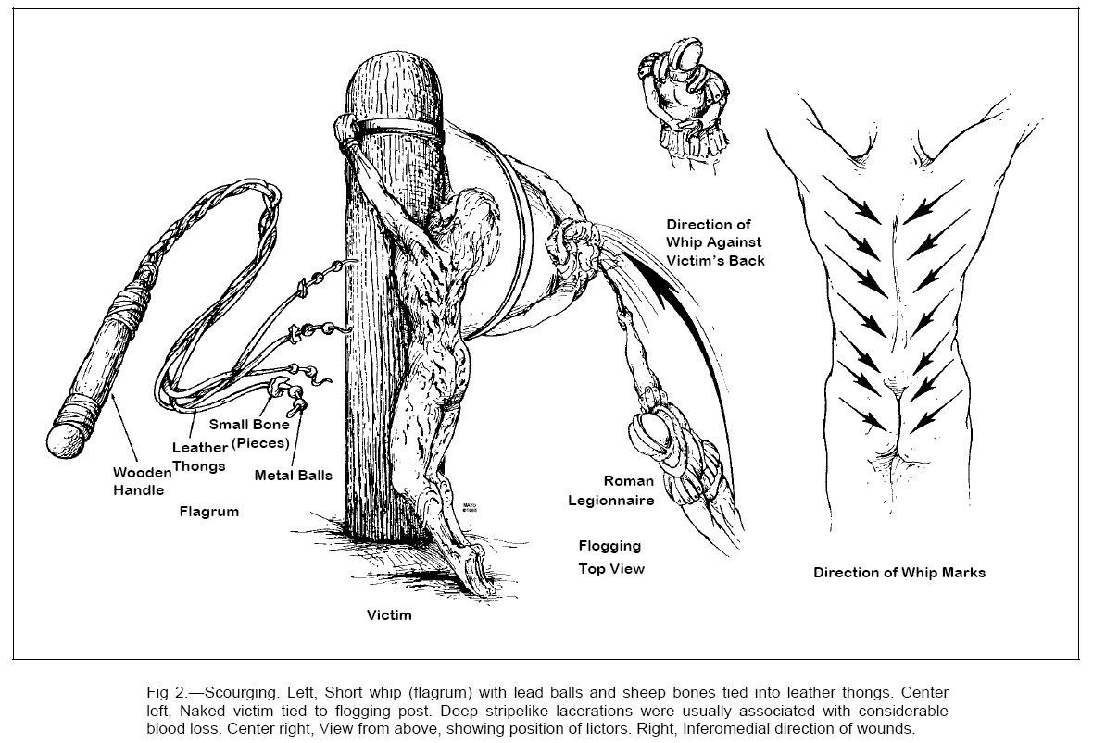
Notes:
Flogging was a requirement before every Roman execution
The usual instrument was a short whip with several leather thongs of variable lengths, in which small iron balls or sharp pieces of sheep bones were tied at intervals
the man was stripped of his clothing, and his hands were tied to an upright post (Fig 2)
The back, buttocks, and legs were flogged on either side by two soldiers
Intension was to weaken the victim to a state just short of collapse or death but not causing death
As the Roman soldiers repeatedly struck the victim’s back with full force, the iron balls would cause deep contusions,
sheep bones would cut into the skin and subcutaneous tissues. Then, as the flogging continued, the lacera- tions would tear into the underlying skeletal muscles
Pain and blood loss generally set the stage for circulatory shock

Slide 3
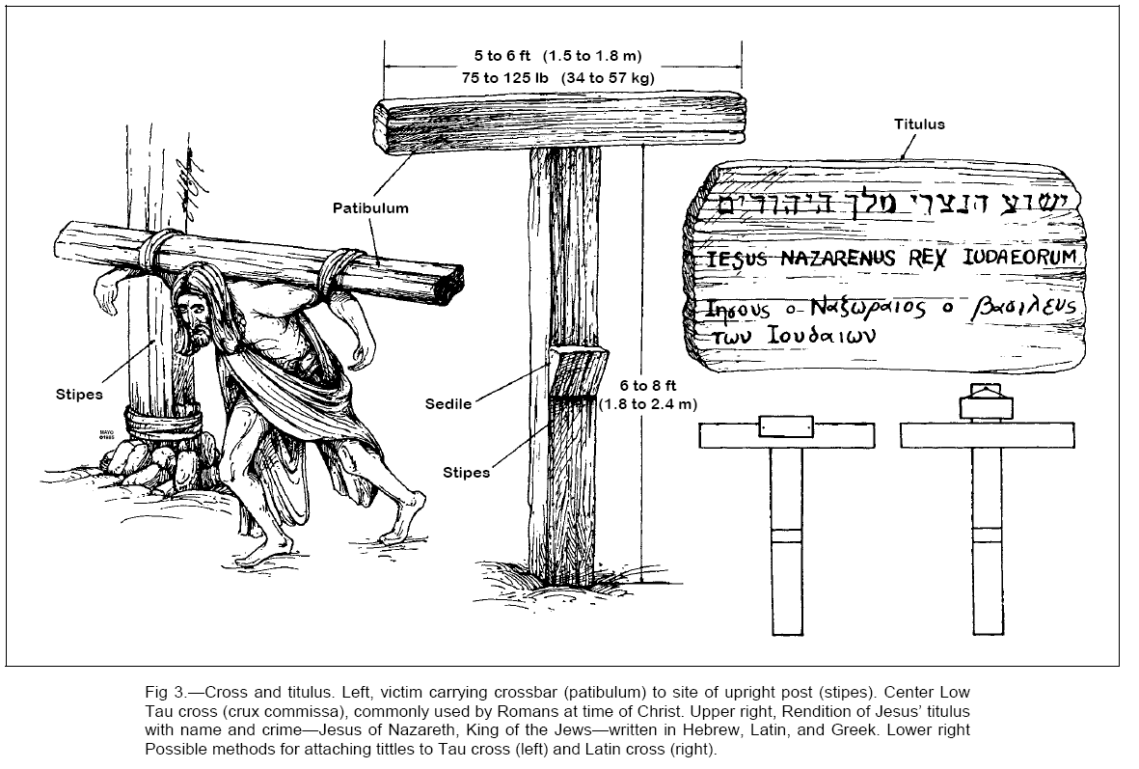
Notes:
Construction of the cross
Made up 4 pieces of wood
The horizontal patibulum, vertical stip, seat sedile, notice tituslus
It was customary for the con- demned man to carry his own cross
from the flogging post to the site of crucifixion outside the city walls. He was usually naked, unless this was prohibited by local customs.
Since the weight of the entire cross was probably well over 300 lb (136 kg), only the crossbar was carried (Fig 3). The patibulum, weighing. (34 to 57 kg), was placed across the nape of the victim’s neck and balanced along both shoulders. Usually, the outstretched arms then were tied to the crossbar. The procession to the site of crucifixion was led by a complete Roman military guard, headed by a centurion.One of the soldiers carried a sign (titulus) on which the condemned man’s name and crime were displayed Later, the titulus would be attached to the top of the cross. The Roman guard would not leave the victim until they were sure of his death.
John 19:19 Pilate had a notice prepared and fastened to the cross. It read: jesus of nazareth, the king of the jews.
Understandbly the Jewish leaders were upset at what was written on the sign
Matthew 16:24 Then Jesus said to his disciples, "Whoever wants to be my disciple must deny themselves and take up their cross and follow me.”
Jesus disciples knew what Jesus meant by those words. History and culture has changed the meaning of what carrying the cross

Slide 4
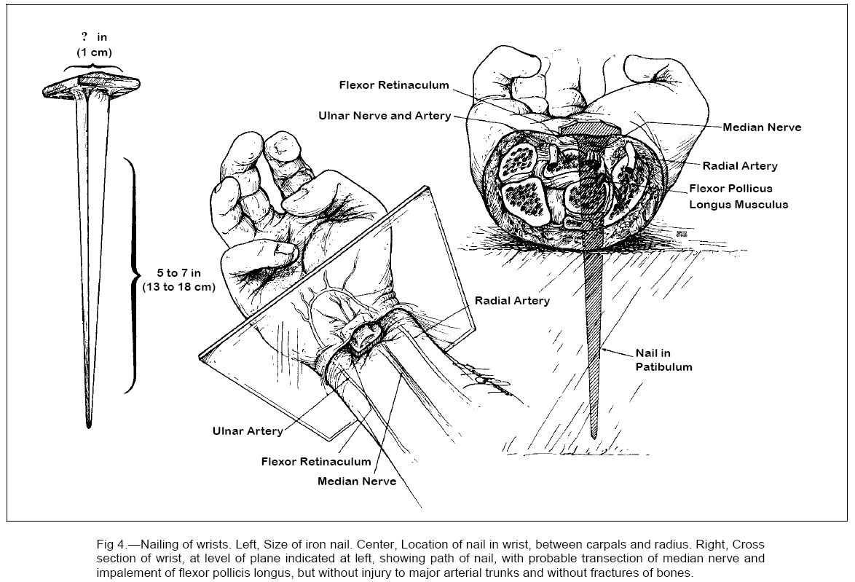
Notes:
the nails were tapered iron spikes approximately 5 to 7 in (13 to 18 cm) long with a square shaft 3/8 in (1 cm)
At the site of execution, the victim was given a bitter drink of wine mixed with myrrh (gall) as a mild analgesic. The criminal was then thrown to the ground on his back, With arms outstretched but not taut, the wrists were nailed to the patibulum. It has been shown that the ligaments and bones of the wrist can support the weight of a body hanging from them, but the palms cannot. Accordingly, the iron spikes probably were driven between the radius and the carpals or between the two rows of carpal bones
the driven nail would crush or severe the rather large median nerve. The stimulated nerve would produce ex-cruciating bolts of pain in both arms. Similar or worse than sciatica like pain

Slide 5
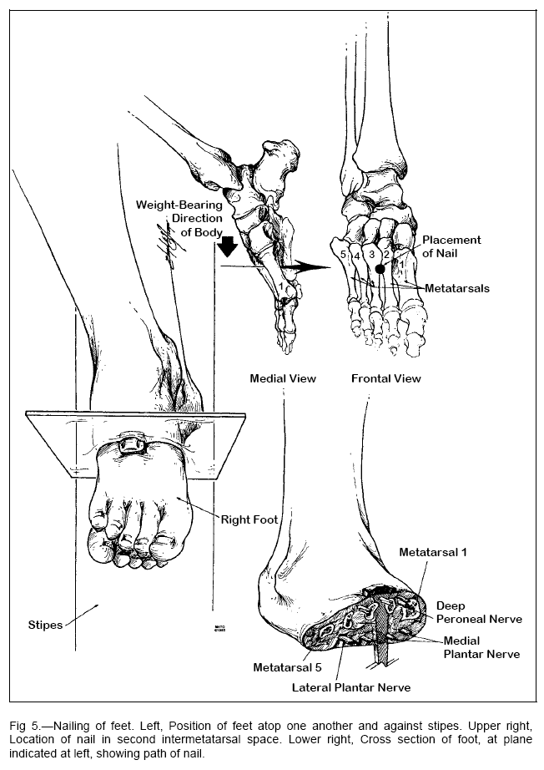
Notes:
Next, the feet were fixed to the cross, they usually were nailed directly to the front of the stipes (Fig 5).11 To accomplish this, flexion of the knees may have been quite prominent, and the bent legs may have been rotated laterally
the feet were fixed to the front of the stipes by means of an iron spike driven through the first or second intermetatarsal space, just distal to the tarsometatarsal joint.2,5,8,11,30 It is likely that the deep peroneal nerve and branches of the medial and lateral plantar nerves would have been injured by the nails (Fig 5).
crucifixion per se was a relatively bloodless procedure

Slide 6
John 19:36
These things happened so that the scripture would be fulfilled: “Not one of his bones will be broken,

Slide 7
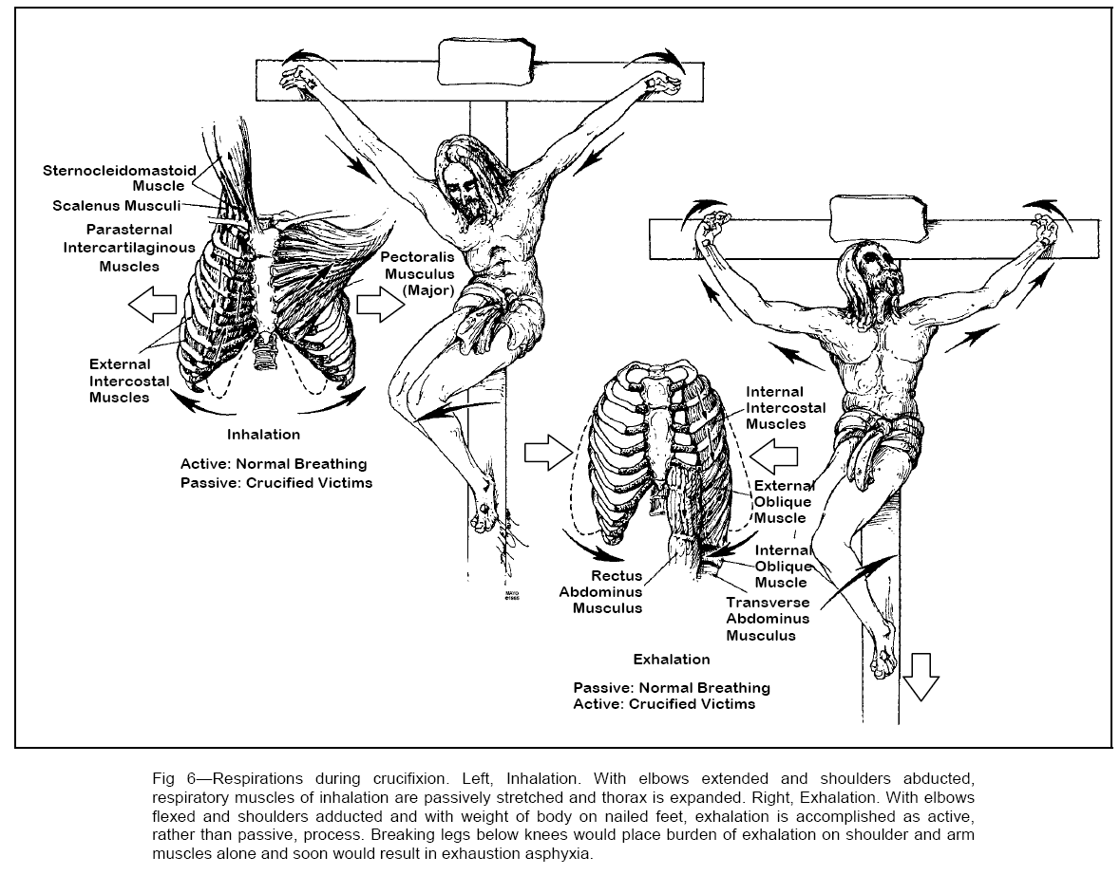
Notes:
The major pathophysiologic effect of crucifixion, beyond the excruciating pain, was a interference with normal respiration, particularly exhalation (Fig 6). The weight of the body, pulling down on the out- stretched arms and shoulders, would tend to fix the intercostal muscles in an inhalation state and thereby hinder passive exhalation
Adequate exhalation required lift ing the body by pushing up on the feet and by flexing the elbows and adducting the shoulders (Fig 6).2 However, this maneuver would place the entire weight of the body on the tarsals and would produce searing pain. Furthermore, flexion of the elbows would cause rotation of the wrists about the iron nails and cause fiery pain along the damaged median nerves. Lifting of the body would also painfully scrape the scourged back against the rough wooden stipes
After exhalation , the criminal would then relax back onto the stool on the cross in a inhalation phase. So the stool was meant to prolong the life of the person
As a result, each respire- tory effort would become agonizing and tiring and lead eventually to asphyxia.
The actual cause of death by crucifixion was multifactorial and varied somewhat with each case, but the two most prominent causes probably were hypovolemic shock and exhaustion asphyxia Other possible contributing factors included dehydration,7,16 stress-induced arrhythmias, and congestive heart failure with the rapid accumulation of pericardial and per- haps pleural effusions.
Breaking the legs below the knees would led to an asphyxic death within minutes.
Death by crucifixion was, in every sense of the word, excruciating (Latin, excruciatus, or “out of the cross”).
Since the Jews did not want the bodies to remain on the crosses after sunset, the beginning of the Sabbath, they asked Pontius Pilate to order crucifracture to hasten the deaths of the three crucified men. The soldiers broke the legs of the two thieves, but when they came to Jesus and saw that he was already dead, they did not break his legs. Rather, one of the soldiers pierced his side, probably with an infantry spear, and produced a sudden flow of blood and water.

Slide 8
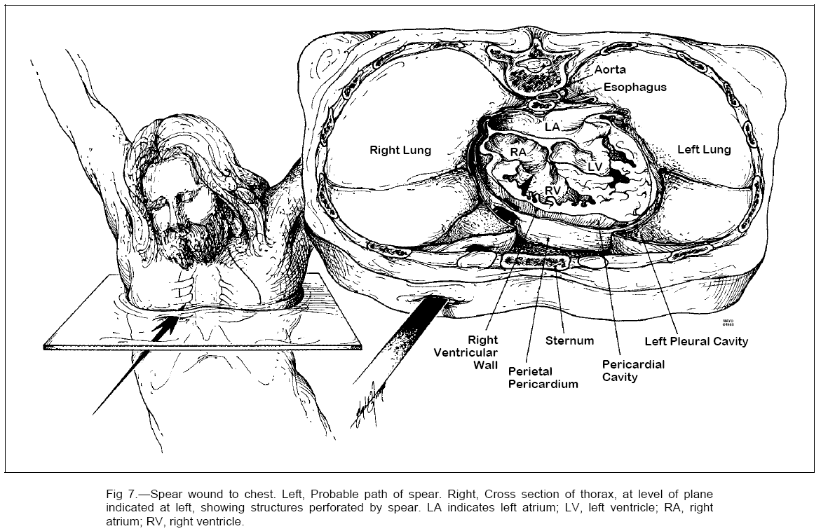
Notes:
Soldiers are trained to check if the enemy is dead. I was in the Singapore armed forces for 2 .5 years as part of a compulsory national enlistement. I remembered we were taught during basic traning how to Check for signs of life – movement, breathing. If we were not sure, we could attach a bayonet to the rifle to poke or stab the enemy
Medical checking is different. Breathing, pulse, fixed and dilated pupils
Christ spoke seven times from the cross.1 Since speech occurs during exhalation, these short, terse utterances must have been particularly difficult and painful. At about 3 PM that Friday, Jesus cried out in a loud voice, bowed his head, and died. Th Roman soldier especially those watching over the cruxificion are professionals when checking for signs of life. That’s why the soldiers did not fracture Jesus legs. They are already determined that he was dead. And just like our modern soldiers, The soldier had a 1.5-1.8m spear which he used to confirm death by piercing.
The gospel of John describes the piercing of Jesus’ side and emphasizes the sudden flow of blood and water. Some authors have interpreted the flow of water to be ascites or urine, from an abdominal midline perforation of the bladder
Traditionally the spear wound was through between right side of the ribs into the heart.
Therefore, the water probably represented serous pleural and pericardial fluid, The blood, in contrast, may have originnated from the right atrium or the right ventricle

Slide 9
Cause of Jesus death
Notes:
Jesus’ died after only three to six hours on the cross. That was relatively a quick deatht. The cruxificion process was meant to kill the criminal slowly over a few days. And after death, the body was kept on the cross for display for a few more days. All these to show the world what it mean to defy the roman empire.
One popular explanation has been that Jesus died of cardiac rupture. In the setting of the scourging and crucifixions with associated hypovolemia, hypoxemia, and perhaps an altered coagulable state, friable thrombotic vegetations could have formed on the aortic or mitral valve. These then could have dislodged and embolized into the coronary circulation and thereby pro duced an acute transmural myocar- dial infarction. Thrombotic valvular vegetations have been reported to develop under analogous acute traumatic conditions. Rupture of the left ventricular free wall may occur, though uncommonly, in the first few hours following infarction.
However, another explanation may be Jesus’ death may have been hastened simply by his state of exhaustion and by the severity of the scourging, with its resultant blood loss and preshock state. The fact that he could not carry his patibulum. supports this interpretation.
The actual cause of Jesus’ death, like that of other crucified victims, may have been multifactorial and related primarily to hypovolemic shock, exhaustion asphyxia, and perhaps acute heart failure. A fatal cardiac arrhythmia may have accounted for the apparent catastrophic terminal event.
Thus, it remains unsettled how Jesus died. However, the important feature may be not how he died but rather whether he died. Clearly, the weight of historical and medical evidence indicates that Jesus was dead before the wound to his side was inflicted and supports the traditional view that the spear, thrust between his right ribs, probably perforated not only the right lung but also the pericardium and heart and thereby ensured his death

Slide 10
John 10:18
No one takes it from me, but I lay it down of my own accord. I have authority to lay it down and authority to take it up again. This command I received from my Father.”
Notes:
My version
My explanation. Jesus took his own life but it was not suicide
Jesus was still able to drink and call in a loud voice just moments before he died. This is not a sign of a man in respiratory distress I think Jesus had willed his own spirit and body to separate. Luke 23:46 Jesus called out with a loud voice, “Father, into your hands I commit my spirit.” When he had said this, he breathed his last.
This is a reverse of the creation of human life
Genesis 2:7 Then the Lord God formed a man from the dust of the ground and breathed into his nostrils the breath of life, and the man became a living being.
Human life is different from all other forms of created life. It is the presence of a human body with a spirit residing inside.
I think death occurs when there is separation of body and spirit. So once the body dies, the spirit will leave the body or once the spirit leaves the body, the body will die.

Slide 11
Daily Offerings Numbers 28: 1-8 The Lord said to Moses, “Give this command to the Israelites and say to them: ‘Make sure that you present to me at the appointed time my food offerings, as an aroma pleasing to me.’ Say to them: ‘This is the food offering you are to present to the Lord: two lambs a year old without defect, as a regular burnt offering each day. Offer one lamb in the morning and the other at twilight, together with a grain offering of a tenth of an ephah of the finest flour mixed with a quarter of a hin of oil from pressed olives. This is the regular burnt offering instituted at Mount Sinai as a pleasing aroma, a food offering presented to the Lord.
Notes:
Tamid
Jesus timed his hour of being nailed to the cross at 9am and his death at 3pm
As a witness that he is the true unblemished sacrificial lamb that takes away sins
The Passover sacrifice occurred the day before Jesus cruxificion. But there was another sacrifice that occured daily in the temple
In Numbers 28 God commanded a daily sacrifice known to the Jew as the tamid
Numbers 28
The Lord said to Moses, “Give this command to the Israelites and say to them: ‘Make sure that you present to me at the appointed time my food offerings, as an aroma pleasing to me.’ Say to them: ‘This is the food offering you are to present to the Lord: two lambs a year old without defect, as a regular burnt offering each day. Offer one lamb in the morning and the other at twilight, together with a grain offering of a tenth of an ephah of the finest flour mixed with a quarter of a hin of oil from pressed olives. This is the regular burnt offering instituted at Mount Sinai as a pleasing aroma, a food offering presented to the Lord.
Tradition was in the temple, 1st lamb sacrificed at 9am and 2nd at 3pm.
At 3pm the priest after sacrificing the 2nd lamb will stay “ It is finished”
So at the same time in John 19:29 When he had received the drink, Jesus said,“It is finished.” With that, he bowed his head and gave up his spirit.

