Slide 1
Body Image
By Ben

Slide 2
Genesis 1:27
So God created mankind in his own image, in the image of God he created them; male and female he created them.

Slide 3
Isaiah 53:2-3
He grew up before him like a tender shoot, and like a root out of dry ground. He had no beauty or majesty to attract us to him, nothing in his appearance that we should desire him. He was despised and rejected by mankind, a man of suffering, and familiar with pain. Like one from whom people hide their faces he was despised, and we held him in low esteem.

Slide 4
What makes someone good looking
Youth
Shape
Balance of muscle & fats
Cultural differences
Skin color
Facial features – eyes, nose, mouth
Others
Voice
mannerism

Slide 5
Songs of Solomon

Slide 6
Chapter 1
She
Kiss
Love
Perfume
He
Cheeks
Neck
Breasts
Eyes
Jewelry
Chapter 2
She
Shade
Banner
Embrace
Encouraging words
Possessive feelings
He
Face
Voice
Perfume
Chapter 3
She
Carriage
(car)
Chapter 4
He
Eyes
Hair
Teeth
Forehead
Neck
Breasts
No flaw
Lips
Fragrance
Chapter 5
She
Wavy black hair
Eye
Cheeks
Lips
Arms
Body
Legs
Chapter 7
He
Feet
legs
waist
umbilicus
breasts
neck
eyes
nose
Head
Hair
Stature
Fragrance

Slide 7
As we age
Discoloration of skin
Drying of skin
Loss of fat
Redistribution of fat
Loss of muscle

Slide 8
Kelly Le Brock
Notes:
Wiki - Kelly Le Brock (born March 24, 1960) is an American actress and model. Her acting debut was in The Woman in Red co-starring with comic actor Gene Wilder. She also starred in the films Weird Science, directed by John Hughes, and Hard to Kill, with Steven Seagal.

Slide 9
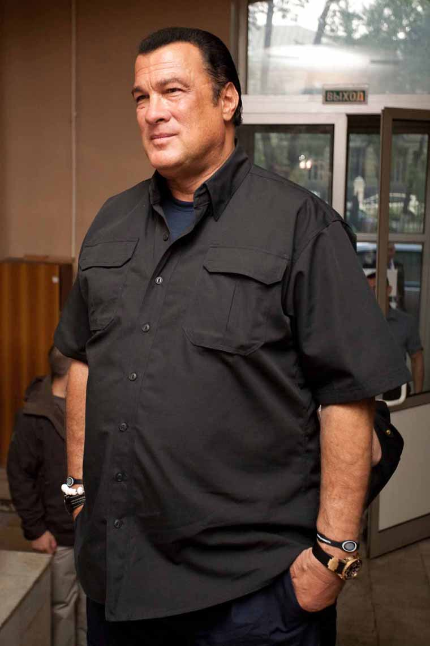
Steven Seagall

Slide 10
Kristie Alley

Slide 11
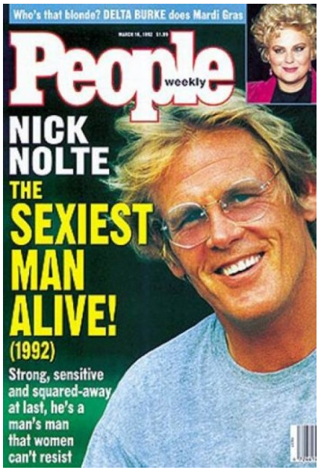
Nick Nolte

Slide 12
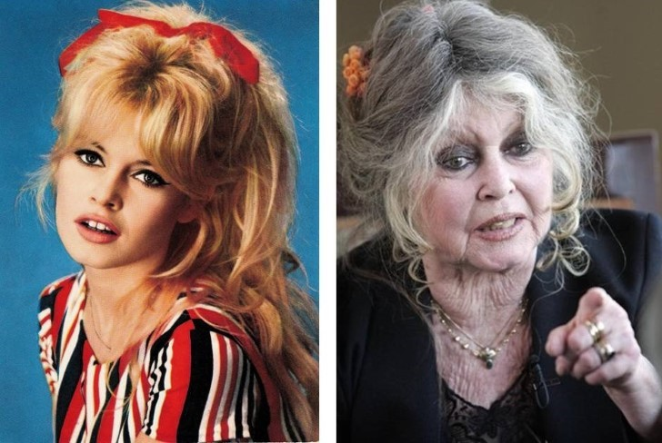
Brigitte Bardot

Slide 13
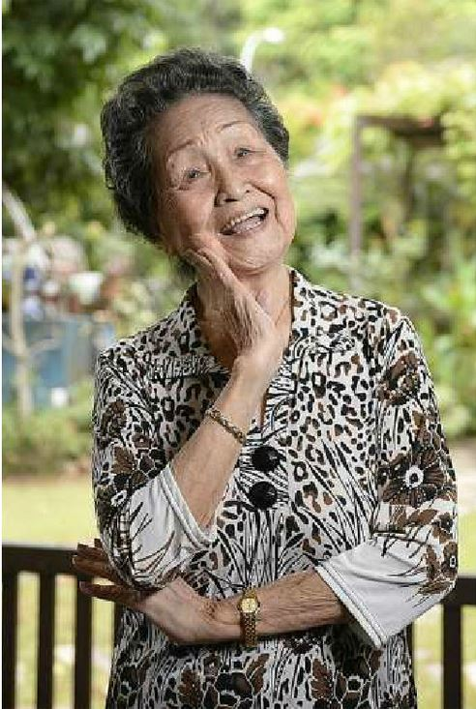
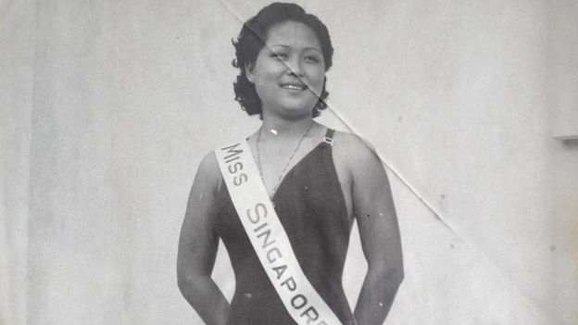
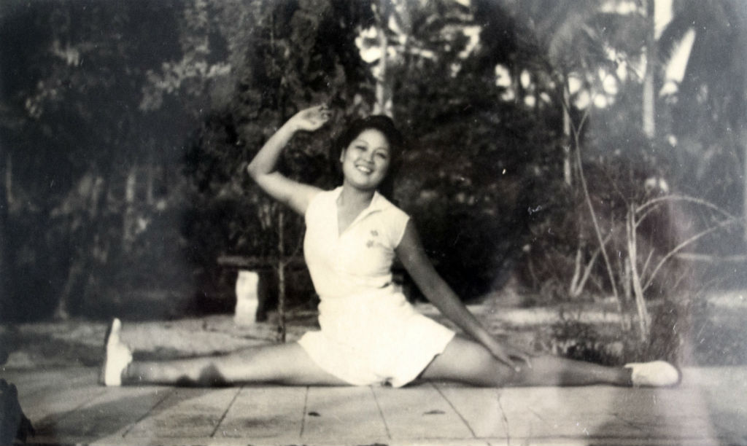
Madam Ho Lye Toh, 92, won the Miss Singapore title three times - in 1941, 1947 and 1948.

Slide 14
Ideal Male image

Slide 15
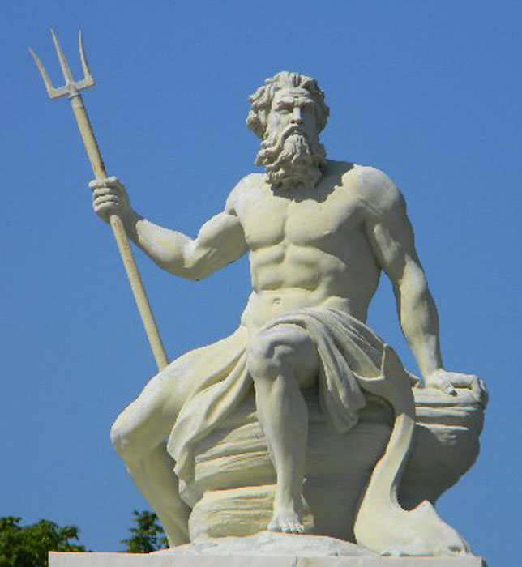
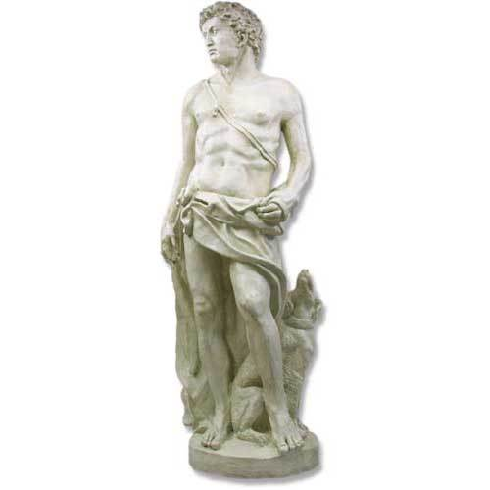
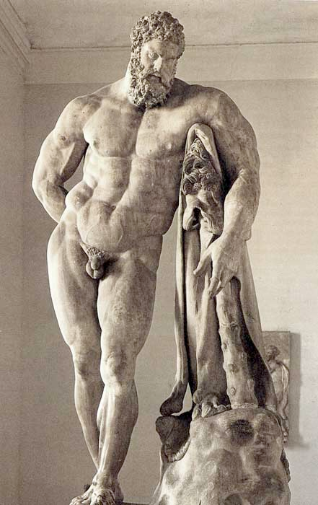
Greek god or hero

Slide 16
Training for men
Exercise – resistance training
Low fat high protien diet
Anabolic steriods – testosterone analogues
Paradoxical idea of gaining muscle and losing fat

Slide 17
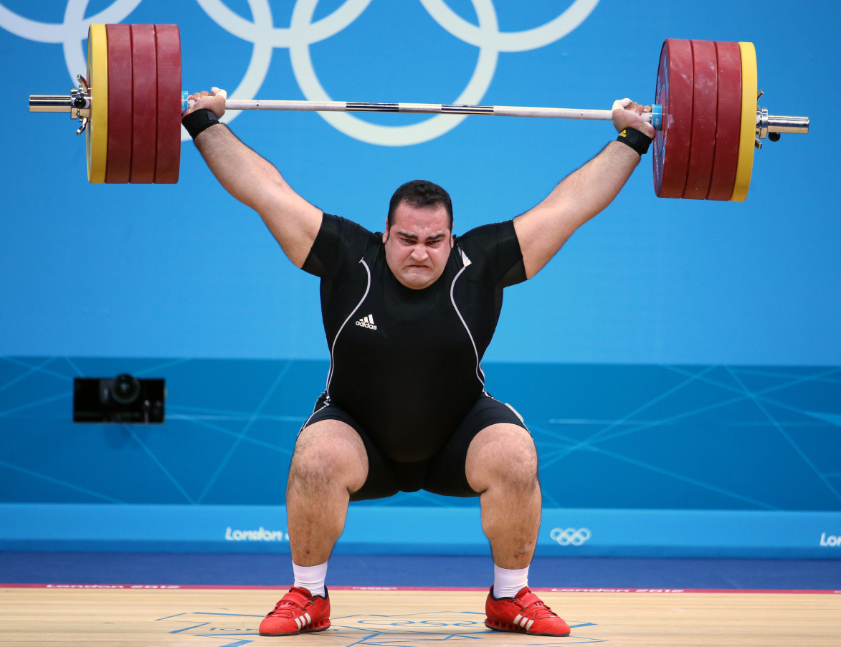
Weight lifter vs body builder
Notes:
The gain muscle and lose fat is a biological paradox.
On the left is a weight lifter. He is likely stronger the body builder on the right.
To gain muscle the weight lifter eats and trains. His concern is strength. So his muscles are not obvious
The body building is a art and science. The art of achieving good and symmetrical muscle definition. Massive muscles a plus point
In body building contest. Science comes to play when body builders have to lose fat but keep the muscle mass. A specialized diet, anabloic steroids and timing for the contest produces this impossible body shape
The body builder on the right is Phil Health. He is Mr Olympia 2011-2014.
The well defined, Greek god body is not long lasting
( To the male students )After you have finished you studies, start working, for most of you there will be no time for regular exercise, or eat with discipline, you will lose this body
And obsession with a muscular body is a male thing
Girls are not very attracted to a ideal male body. Infact most females think body builders like the one on the right as not proportionate or a put off
Remember the converstaions in Songs of Solomon?
What do girls look for in a male?

Slide 18
Ideal Female image

Slide 19
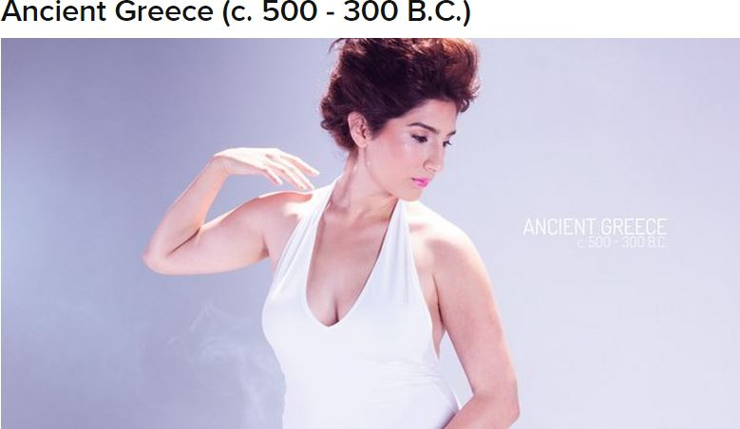
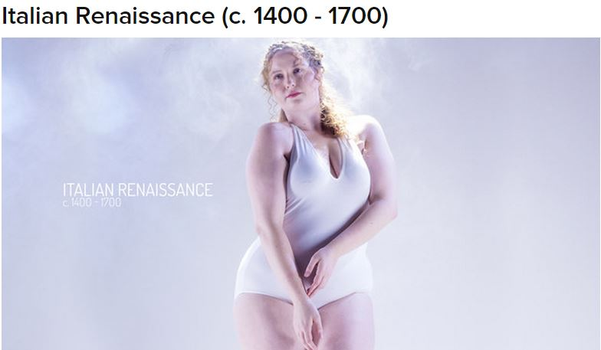

Slide 20
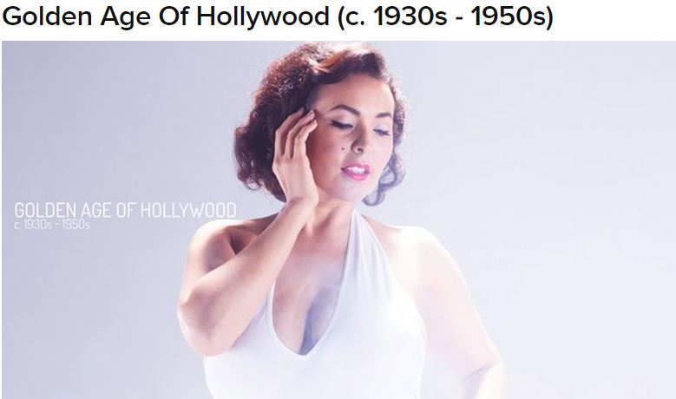
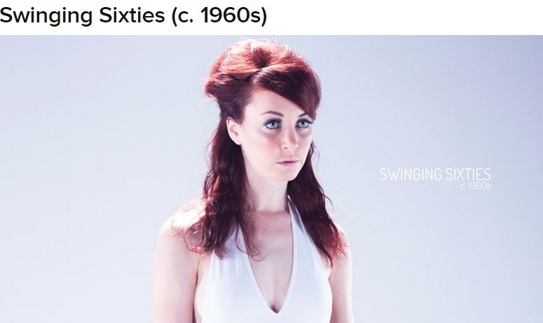
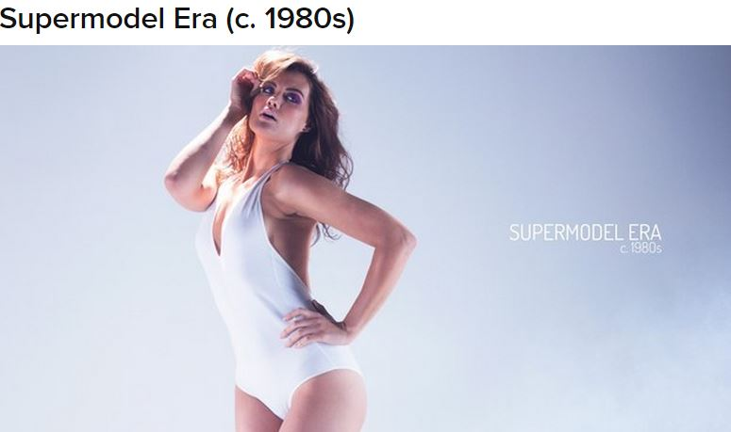

Slide 21
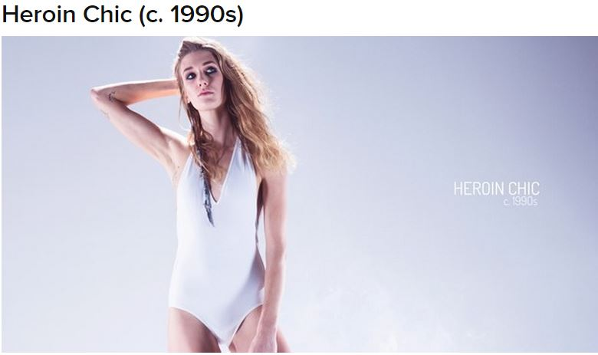

Slide 22
Weight matters
Contents
Basic science
Losing weight diet
difficulties of losing weight

Slide 23
Basic Science of Losing weight
Energy balance
Input = Output
Output = Basal Metabolic rate + daily activity + Exercise

Slide 24
Data from http://nutritiondata.self.com/tools/calories-burned
Male, 30 yrs, 1.75m, 65 kg
Sedentary lifestyle Hardly walks | Sedentary lifestyle Walks up to 4km / day | Sedentary lifestyle Hardly walks Jogs 30min at 8km/h Runs 30min at 17km/h | Gained 30kg to 95 kg Sedentary lifestyle
2376 kCal | 2592kcal | 2376kcal | 2802kcal
 | 2376 – 2376 = 216kcal | 296kcal 728kcal | 2802-2376= 426kcal

Slide 25
Low calorie losing diet is key
Low calorie diet- low enough to have a negative energy balance
Sustain for months to years
Most people who attempt will fail to lose weight
Most people who lose weight will fail to sustain the weight loss. Most will regain weight in 3-5 years

Slide 26
Difficulties of Losing weight
You vs your body
Brain will fight back
Increase hunger pangs, play images of food in your brain, make food look & taste better,
Find excuses to eat
Wear out the motivation in the long run
Body will fight back
Body process will slow down , tired & dull
Process – months to years
Prevention is better than Cure
Notes:
The problem in losing weight is that your body and mind will fight back you effort to lose weight
The process of losing weight is a long drawn out fight that will take years
Therefore prevention is better than cure.
Once there is significant weight gain it is difficult to lose it
Attached is a journal article on the failure of overweight people to cross BMI categories

Slide 27
Make up

Slide 28
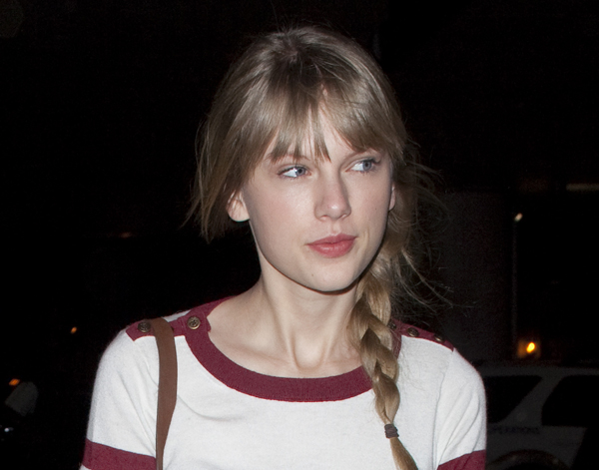
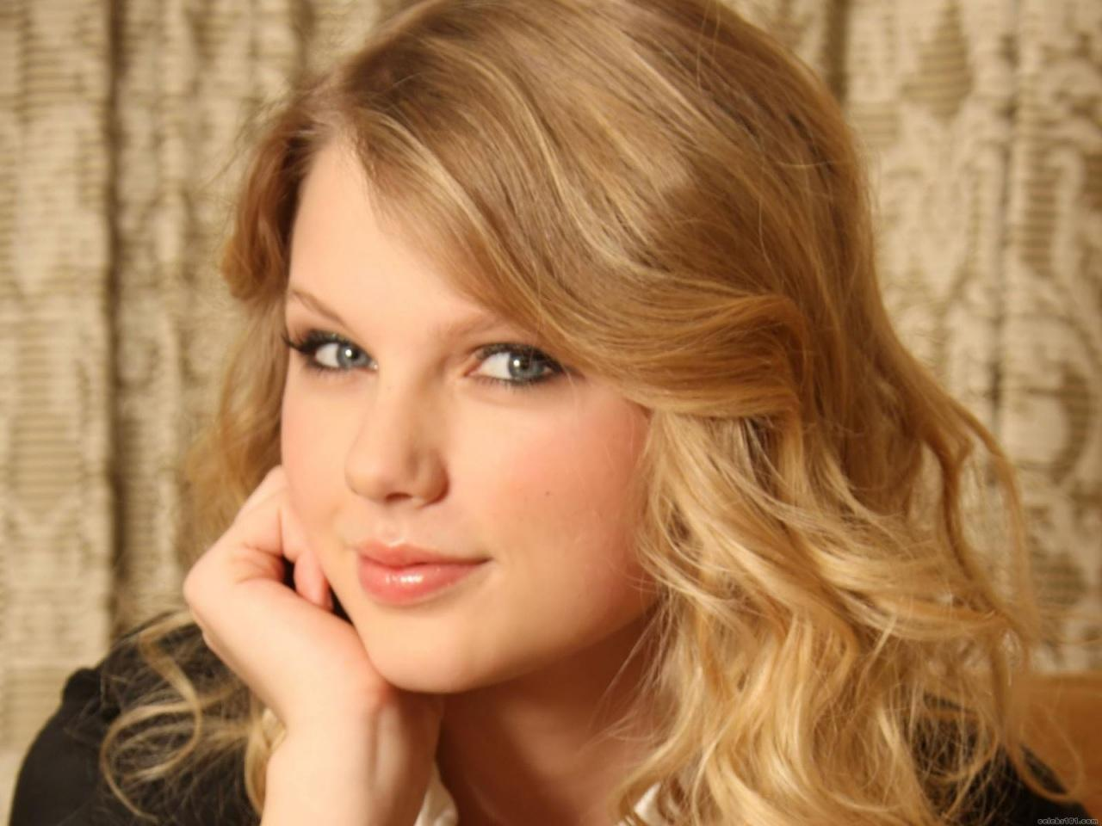
Taylor Swift

Slide 29
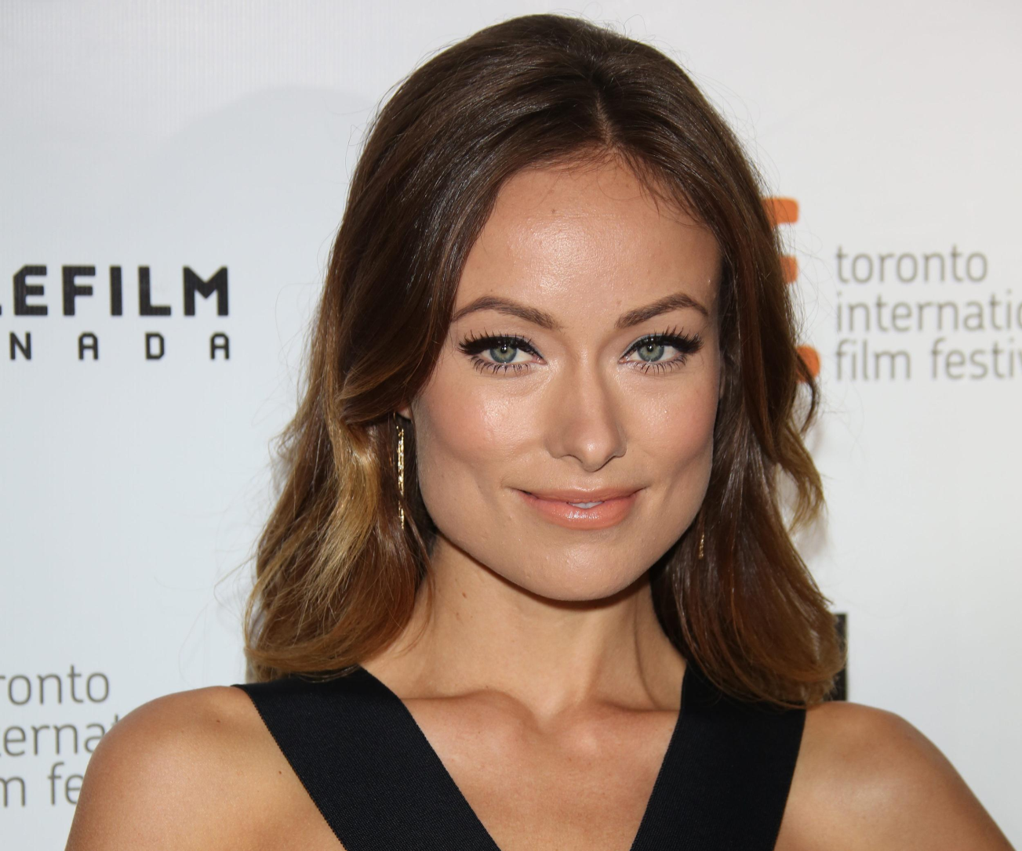
Olivia Wilde

Slide 30
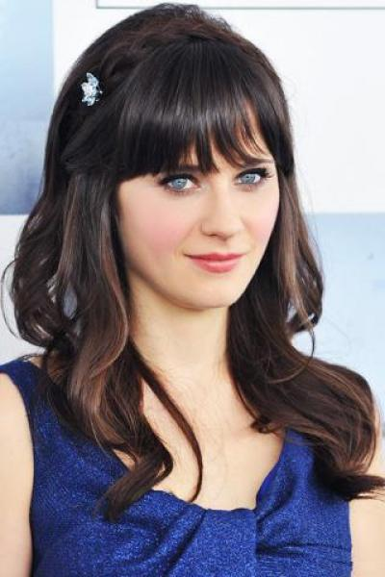
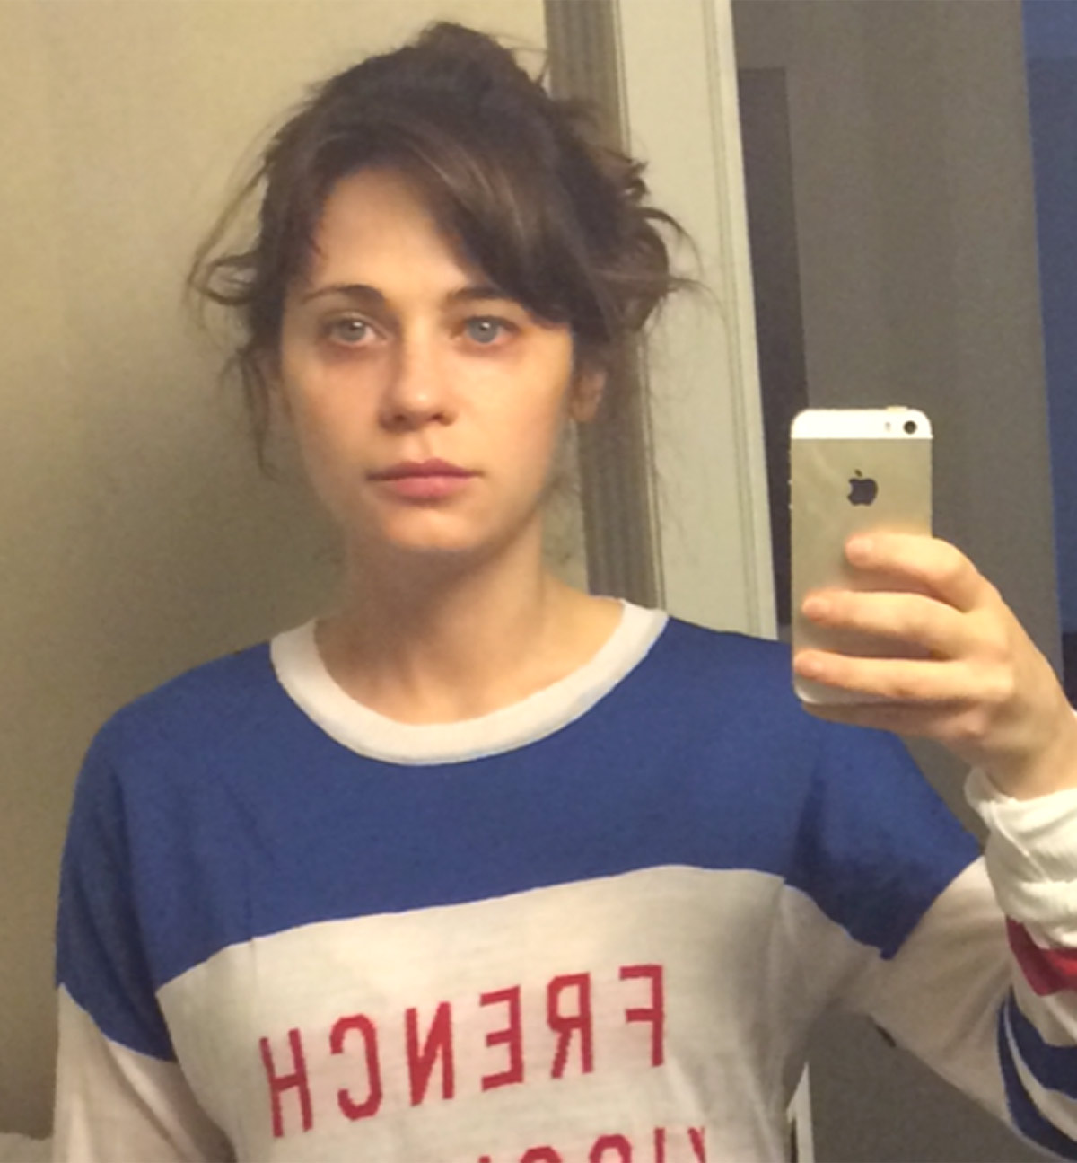
Zooey Deschanel

Slide 31
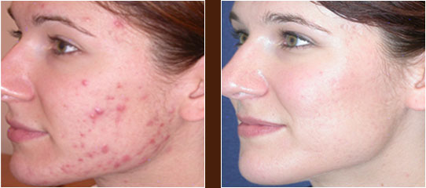
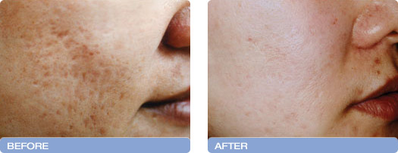
Acne treatment
With Acne creams
Laser treatment for acne scars

Slide 32
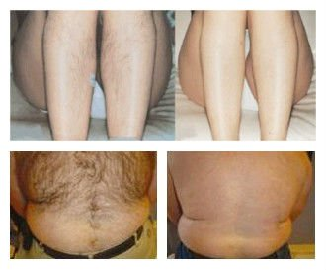
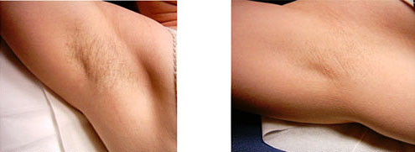
Intense Pulse Light IPL - Hair removal
Notes:
.

Slide 33
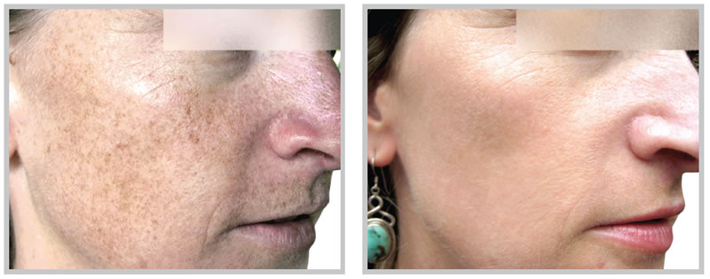
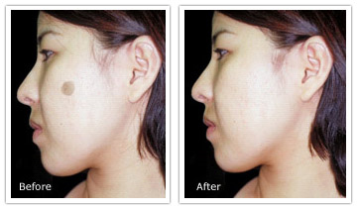
IPL removal of pigments

Slide 34
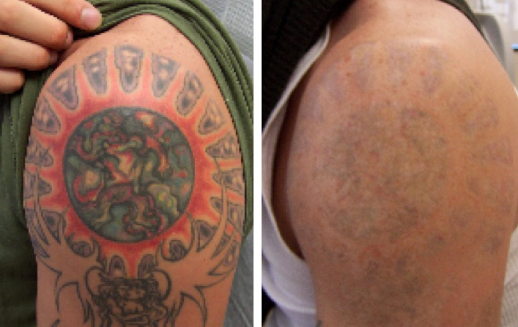
Laser removal of tattoos

Slide 35
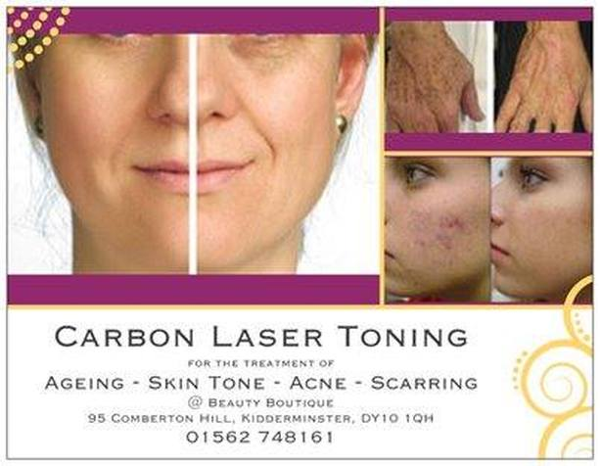
Laser toning

Slide 36
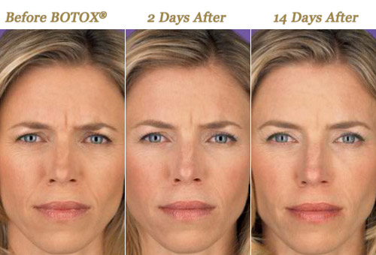
Botox

Slide 37
Liposuction

Slide 38
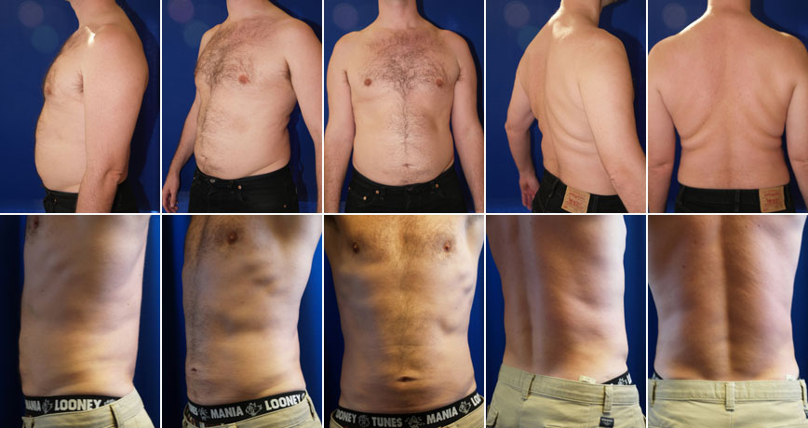

Slide 39
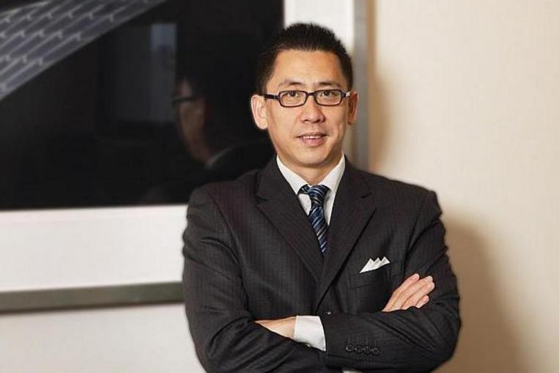

Slide 40
Korean cosmetic surgery

Slide 41
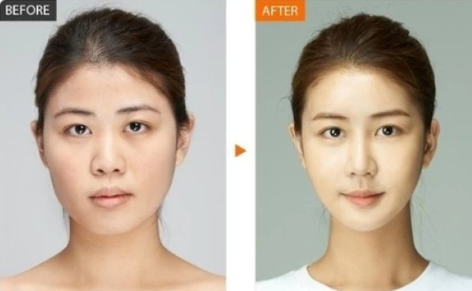

Slide 42
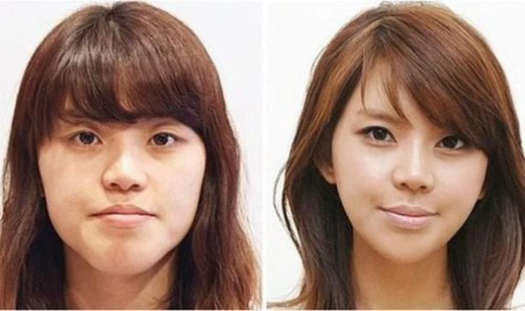

Slide 43
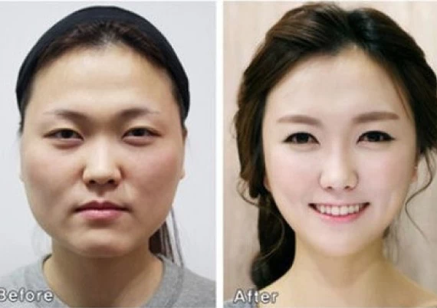

Slide 44
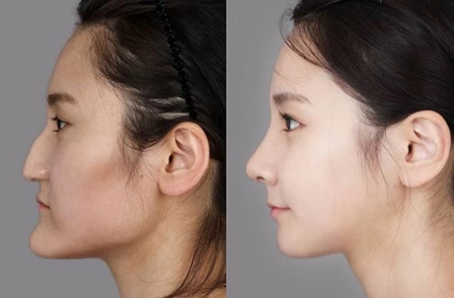

Slide 45
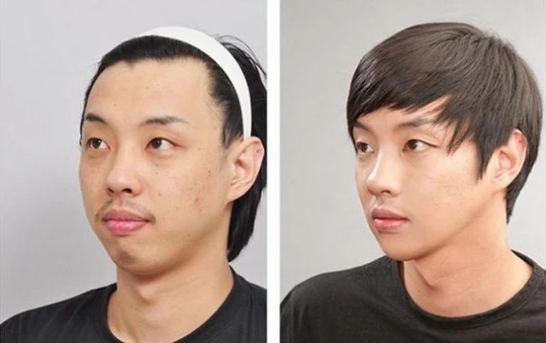

Slide 46
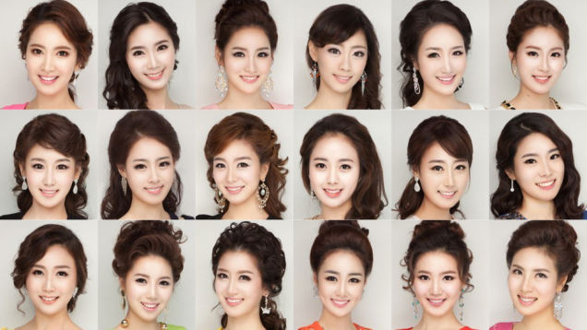
Korean beauty Queen 2013
Notes:
Korean beauty contest has been labeled as a showcase for plastic surgery.
For example many of the 2013 contestants in this slide look the same

Slide 47
Notes:
To demonstrate the sameness of look, 7 of these beauty contestants were chosen and a gif photo was made

Slide 49
The End

